Slide 1


Influence of tweet sentiments on stock market prices
Minqi Liu, Pinki Kumari, Prarthana Govindaraj

Slide 2
Academic programmes
FS ABTEILUNGEN
CONTENTS
Master
Introduction
Data Overview
Sentiment Feature Calculations
Stock Feature Calculations
Lag selection
Random Forest Analysis
Result
Conclusion

Slide 3

INTRODUCTION

Slide 4

INTRODUCTION
Academic programmes
FS ABTEILUNGEN
OVERVIEW
Online platforms have become popular for sharing thoughts
Does sentiment have an impact on financial market?
Interested to know if tweets have impact on company’s market performance
Concentrating on Tesla tweets because Elon Musk is connected to both X and Tesla
Used various methods to determine whether public opinion affects stock prices

Slide 5
DATA OVERVIEW

Slide 6
DATA OVERVIEW
FS ABTEILUNGEN
Input Tweet Data
Date | Tweet | Stock Name | Company Name
2021-09-30 01:16:13+00:00 | In other words, AMD has been giving Tesla preferential treatment bc it knows that most of the legacy OEMs will be gone in a few years. Very smart. $TSLA https://t.co/XvkJhCd4VQ | TSLA | Tesla, Inc.
2021-09-30 01:38:26+00:00 | Get ready for a $TSLA _ _ _ _ _ _ Q3 delivery number. Have ur own answer below ðŸ‘‡ðŸ» | TSLA | Tesla, Inc.
2021-09-30 01:59:02+00:00 | Hold. On. Tight. $TSLA | TSLA | Tesla, Inc.
2021-09-30 02:40:26+00:00 | I agree with @freshjiva that $TSLA â€˜s EV business alone is worth &gt; $1,100/sh w/o FSD. Where we likely disagree: Itâ€™s the marginal ROIC (MROIC) that matters more than the 23% avg ROIC, which is based on invested capital book value. MROIC is the FCF return on cash or market value. https://t.co/kos78KiDuj | TSLA | Tesla, Inc.
2021-09-30 02:52:38+00:00 | Playing in the dirt and #chasingsunsets @tesla @elonmusk @TesCalendar https://t.co/JZOAFjV2zP | TSLA | Tesla, Inc.
Total TSLA tweets = 37422

Slide 7
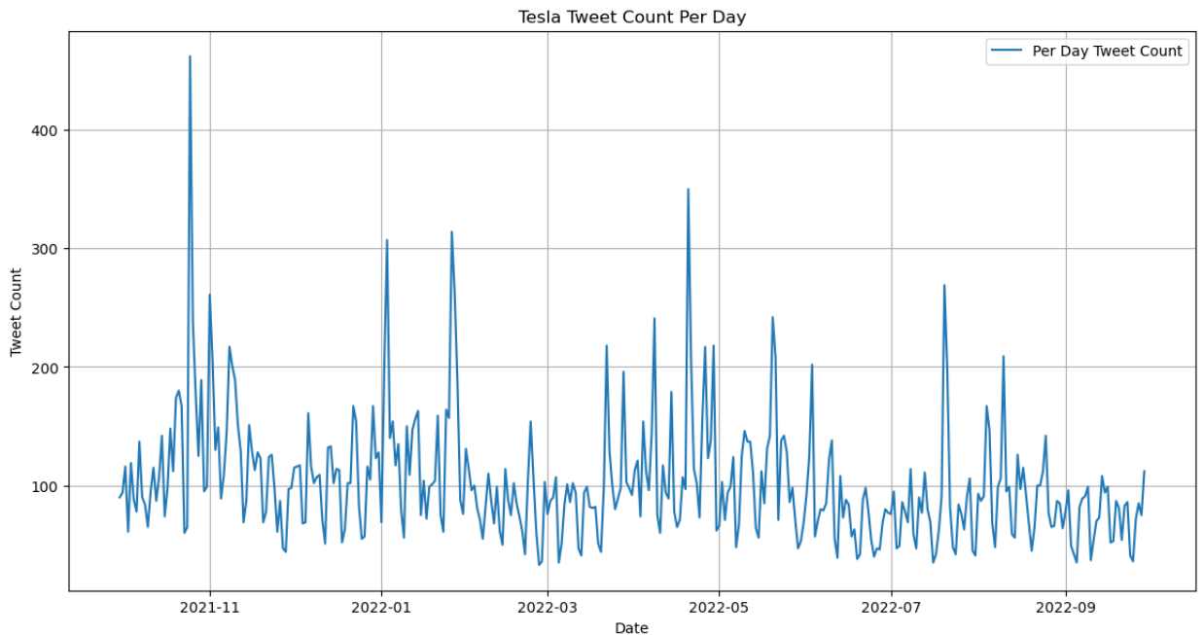
DATA OVERVIEW​
FS ABTEILUNGEN
Tweet data overview

Slide 8
DATA OVERVIEW
FS
Input Stock Data
Date | Open | High | Low | Close | Adj Close | Volume | Stock Name
30-09-2021 | 260.3333 | 263.0433 | 258.3333 | 258.4933 | 258.49335 | 53868000 | TSLA
01-10-2021 | 259.4667 | 260.26 | 254.53 | 258.4067 | 258.40668 | 51094200 | TSLA
04-10-2021 | 265.5 | 268.99 | 258.7067 | 260.51 | 260.51001 | 91449900 | TSLA
05-10-2021 | 261.6 | 265.77 | 258.0667 | 260.1967 | 260.19666 | 55297800 | TSLA
06-10-2021 | 258.7333 | 262.22 | 257.74 | 260.9167 | 260.91666 | 43898400 | TSLA
Total TSLA stock data = 252​

Slide 9
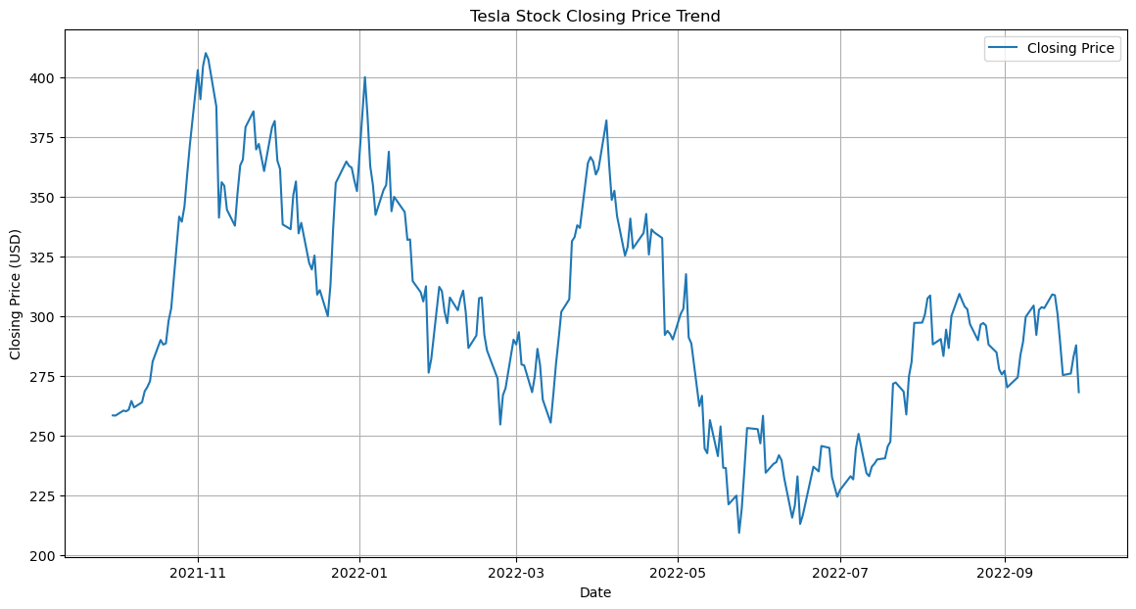
DATA OVERVIEW​
​
Stock data overview

Slide 10
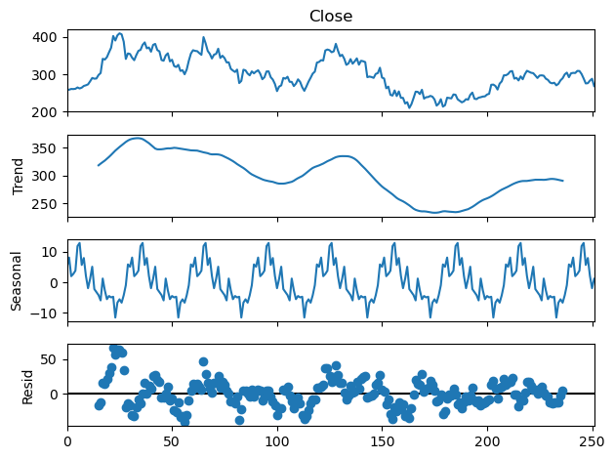
DATA OVERVIEW​​
​​
Stock data overview

Slide 11
SENTIMENT feature calculation

Slide 12
SENTIMENT FEATURE CALCULATION
​​​
Methods to calculate sentiment value -
VADER sentiment analysis
Tool to provide compound sentiment intensity score between –1 (most negative)
and 1 (most positive).
Part of NLTK (Natural Language Toolkit)
TextBlob sentiment analysis
Evaluates polarity and subjectivity.
Polarity – between –1 (negative sentiment) and 1 (positive sentiment)
Subjectivity – between 0 (objective/opinionated) and 1 (subjective)

Slide 13
SENTIMENT FEATURE CALCULATION​
​​​​
Feature | Calculation
Tweet cleanup | remove URL remove @ (mentions) remove special characters remove emoji and non-ASCII characters
Positive count of Tweets | count of tweets with positive sentiment score ( score > 0.05 )
Negative count of Tweets | count of tweets with negative sentiment score ( score < 0.05 )
Neutral count of Tweets | count of tweets with negative sentiment score (score between -0.05 and 0.05
Average Sentiment Score | average of sentiment a day

Slide 14
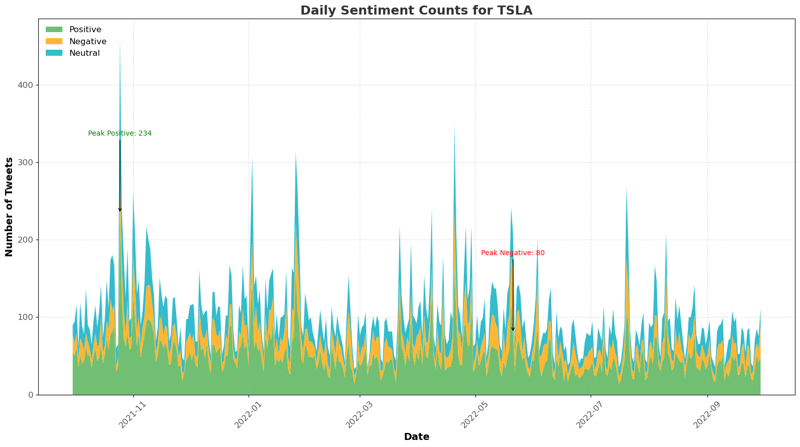
SENTIMENT FEATURE CALCULATION​
​​​​
Descriptive data after sentiment analysis

Slide 15
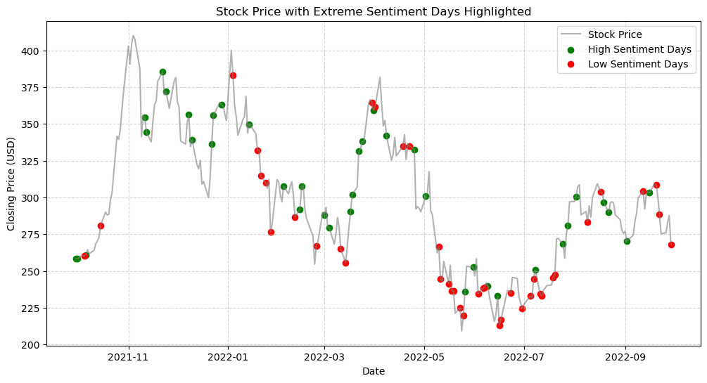
SENTIMENT FEATURE CALCULATION​
​​​​

Slide 16
STOCK feature calculation

Slide 17
STOCK FEATURE CALCULATION
​​​
Feature | Formula
fluctuation | Stock.High - Stock.Low
price_gain | Stock.Close - Stock.Open
total_valuation_eod | Stock.Volume * Stock.Close

Slide 18
lag selection

Slide 19
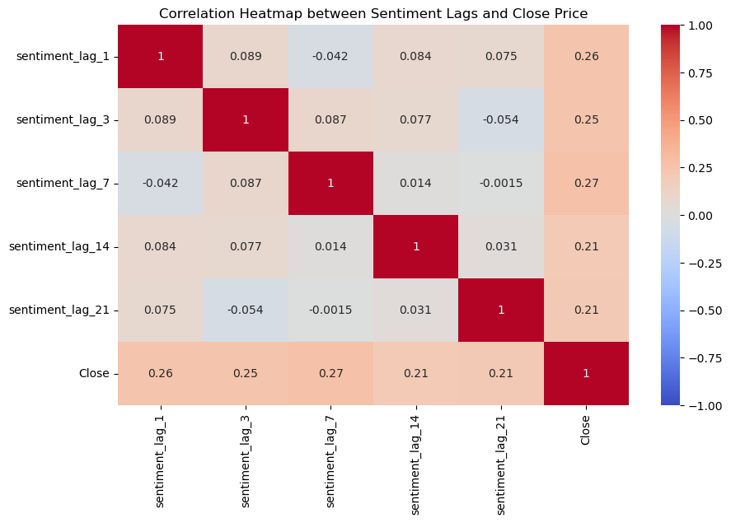
FS ABTEILUNGEN
FEATURE SELECTION
​​​​
Adding lags
Social media sentiment may not affect stock price immediately
Setting potential lags: 1-21
We decided to selected lag7:
Aviod too much multicolinearity;
Balance of Recency and Predictive Power

Slide 20
FEATURE SELECTION​
​​​​​
Final features
Input variables:
Sentiment related: average sentiment score, sentiment score lag7, positive tweet counts, negative tweet counts
Financial factors: total valuation, price gained, fluctuation
Target variable: price trend

Slide 21
RANDOM FOREST ANALYSIS

Slide 22
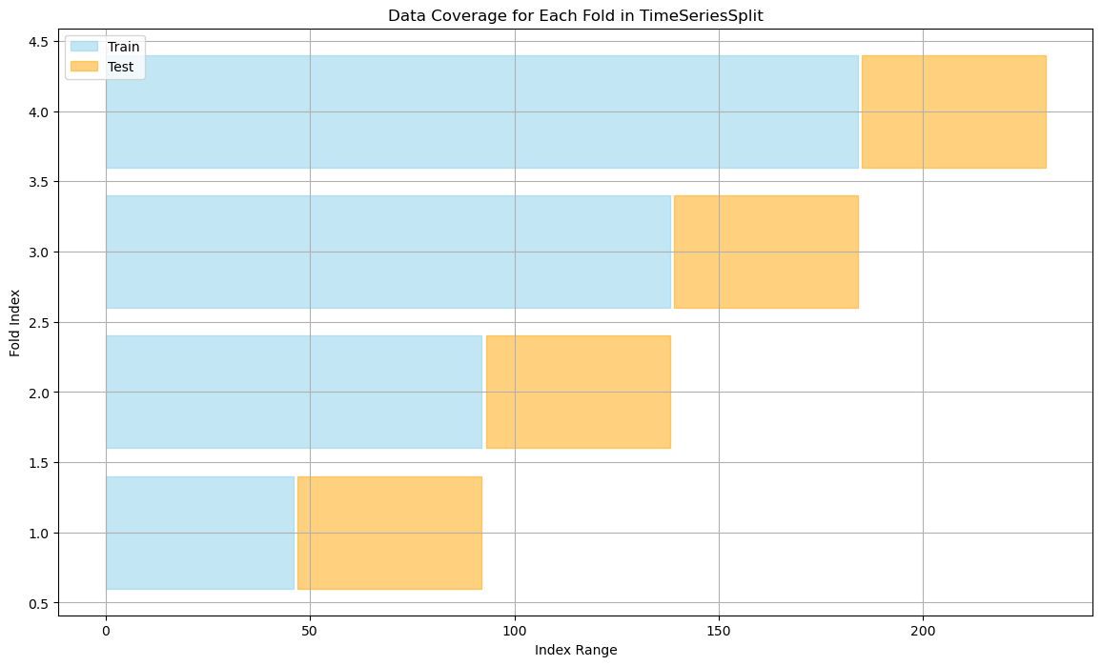
RANDOM FOREST ANALYSIS
​​​​​​
FS ABTEILUNGEN
Timeseries spliting: Cross Validation method
Preserves temporal order
Expanding training set
Captures trends and seasonal
Patterns: 4 folds

Slide 23

Academic programmes
FS ABTEILUNGEN
Model selection
Logistic Regression: not suitable for imbalanced dataset and complex relationships
Mean F1 Score: 0.35, Mean ROC AUC Score: 0.41
Random Forest solves the issues above:
Using Grid Search to find the best combination of hyperparameters for f1

Slide 24
Results

Slide 25
Academic programmes
FS ABTEILUNGEN
Evaluation: F1 and ROC AUC score
F1: balance Precision and Recall; for unbalanced dataset, a better measure in detecting the minority class.
ROC AUC score: indicate the model ability in distinguishing positive and negative cases
Unbalaneced dataset
More positive average sentiment score; more positive tweet counts...

Slide 26
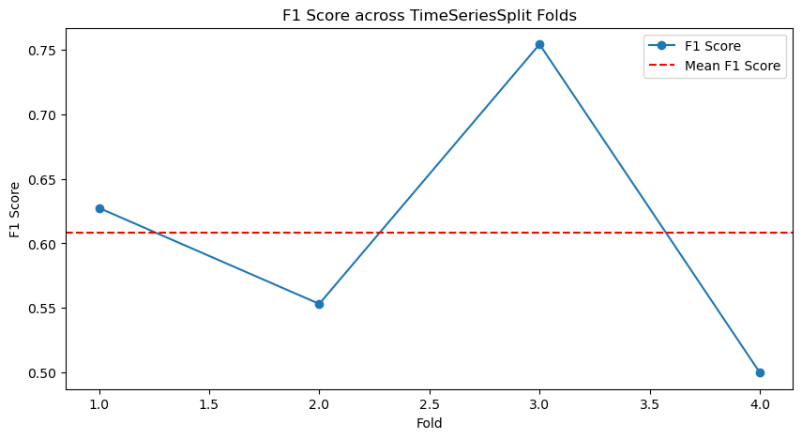
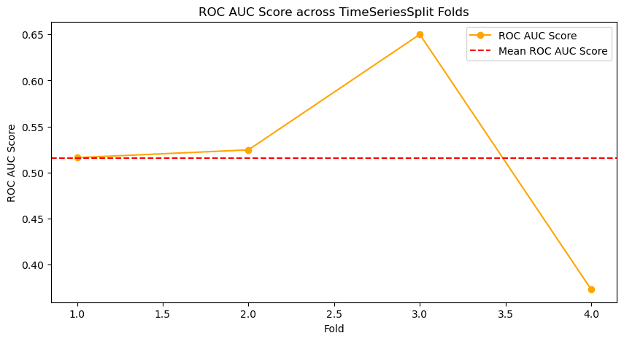
Academic programmes
FS ABTEILUNGEN
F1 and ROC AUC score for 4 folds
Mean F1 score: 0.61
Mean ROC AUC socre: 0.52
The model is not performing well for the last fold

Slide 27
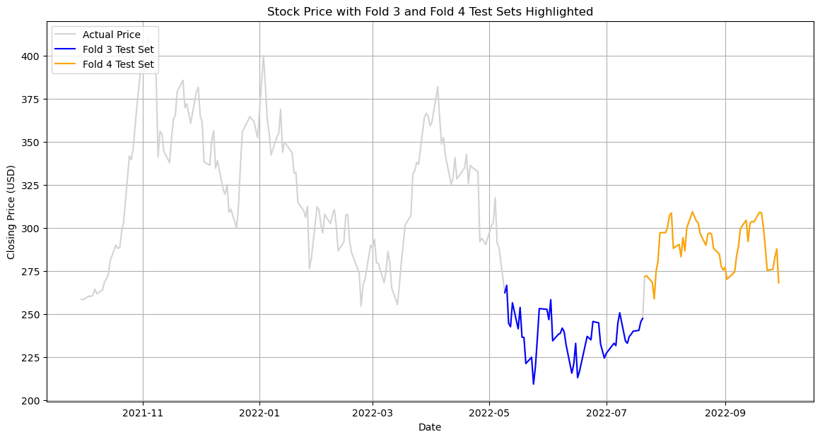
Academic programmes
FS ABTEILUNGEN
The Third fold vs the last fold

Slide 28
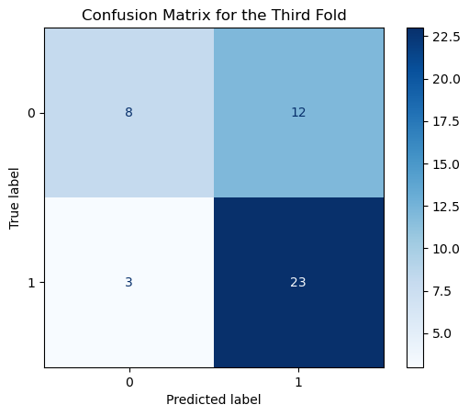
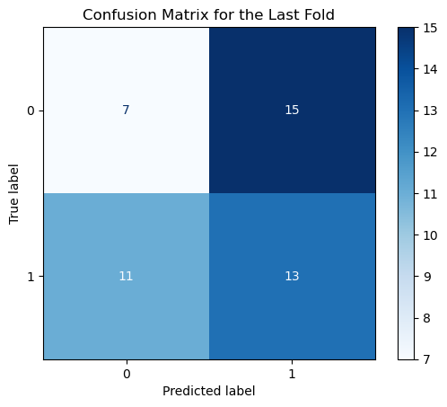
Academic programmes
FS ABTEILUNGEN
F1 score and confusion matrix for the last fold vs the third fold
F1 Score for the Third fold: 0.75
F1 Score for the Last fold: 0.50

Slide 29
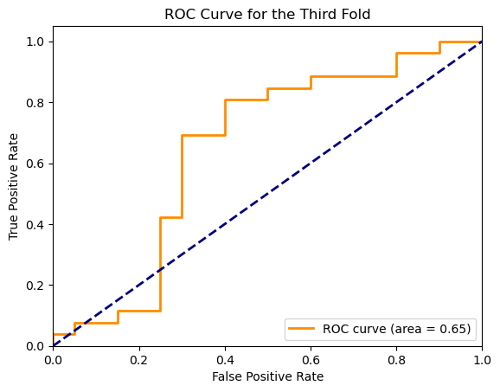
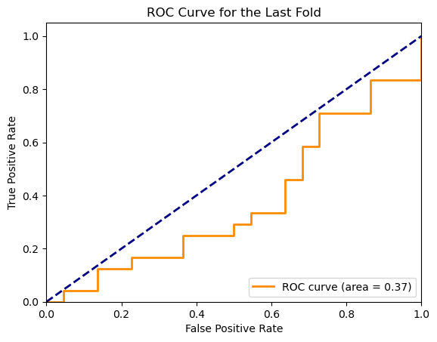
Academic programmes
FS ABTEILUNGEN
ROC AUC Score for the last fold vs the third fold

Slide 30
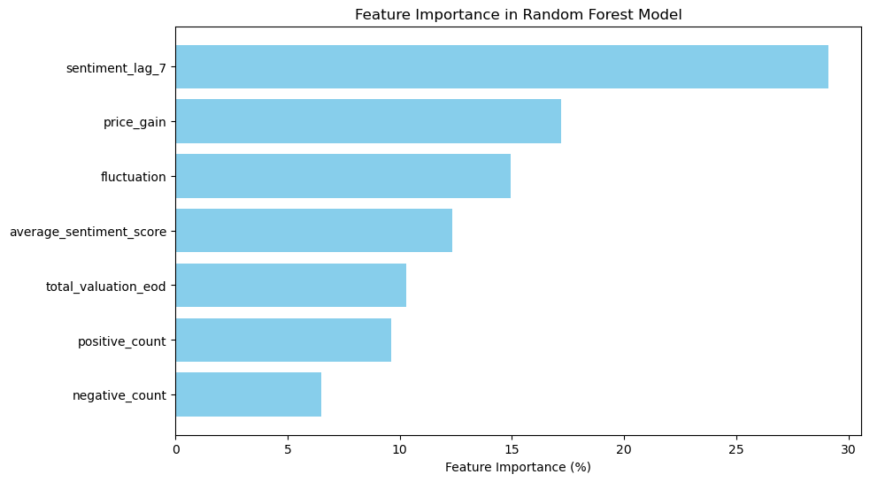
Academic programmes
FS ABTEILUNGEN
Feature importance: in general

Slide 31
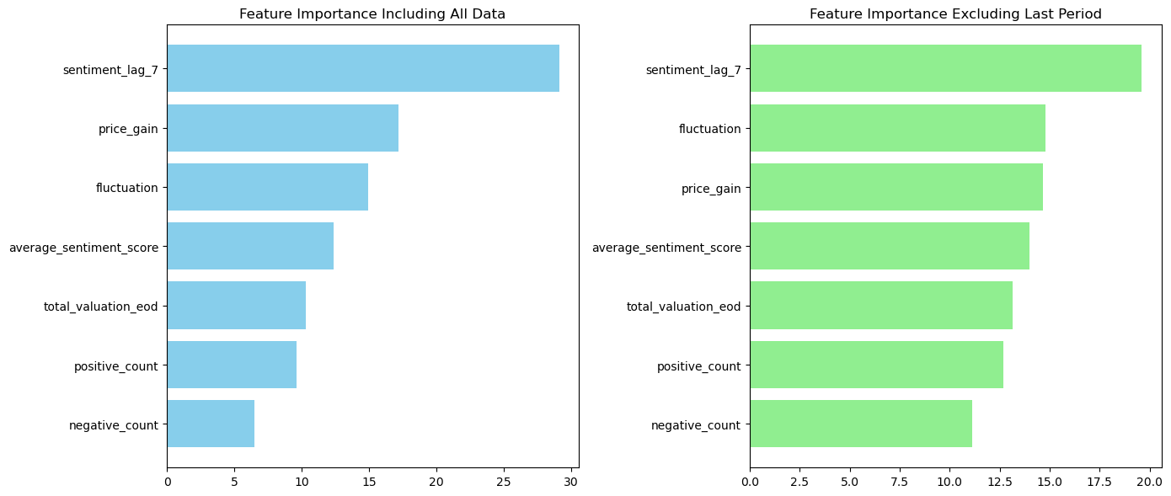
Academic programmes
FS ABTEILUNGEN
Feature importance: comparison
Sentiment score with lag of 7 days plays the most significant role in both graph
Sentiment particularly impactful during the last period

Slide 32
Academic programmes
FS ABTEILUNGEN
Feature importance
Sentiment has significant imapct in predicting the price trend :
The sentiment lag for 7 days plays a more significant role then current one, regardless of the model stability: social media influence the price over time (one week) rather than immediately
Positive and negative tweet counts with lower importance: raw counts of sentiment may not
capture enough context for predicting trends
Financial indicators: Fluctuation and price gain are the more important financial feature in this model

Slide 33
Potential explainations
Academic programmes
FS ABTEILUNGEN
Different market environment: More news after 2022.08 -> unpredictable pattern
- Tesla Shareholder Meeting: 3 for 1 stock split, more stock for investors and employees
- Elon Musk Twitter Acquisition: almost done, investors jittered for sometime and then confidence grew
- Low global demand of EV's due to high inflation and high interest rate
- Supply chain disruption resulting in semiconductor shortage in the aftermath of COVID
2. Unbalanced and limited dataset:
- More positive sentiment
- Only contains of one-year data
- Better if we can weight tweets based on the retweet and follower number

Slide 34
Academic programmes
FS ABTEILUNGEN
Conclusion
Impact of tweets can be observed with 7 days of lag
Sentiment feature is not the strongest feature
Other financial features and global market has greater influence in company's performance
Potential future study:
Considering Elon Musk's tweets: his tweets may be impactful on X and affect investors' reaction
Predicting the stock price with more macro indicators and combined with real-world events

Slide 35
THAnk you !

Slide 36
GITHUB & SOURCES
GITHUB REPOSITORY
https://github.com/PRARTHANA-G01/Sentiment_Stock_Relation
SOURCES
https://www.kaggle.com/datasets/equinxx/stock-tweets-for-sentiment-analysis-and-prediction/data
REFERENCES
ChatGPT
Find functions that support our requirement of data processing and its working

